Slide 1
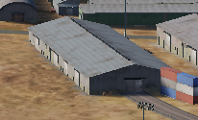
 | 500 IBS | 1000 IBS | 2000 IBS
1x Bomb | X | V | V
2x Bombs | V | V | V
4x Bombs | V | V | V

Slide 2
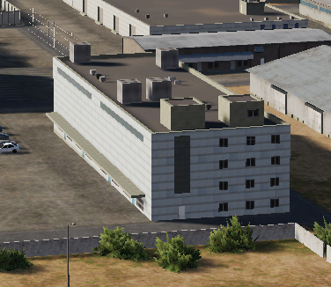
 | 500 IBS | 1000 IBS | 2000 IBS
1x Bomb | X | X | V
2x Bombs | X | V | V
4x Bombs | V | V | V

Slide 3
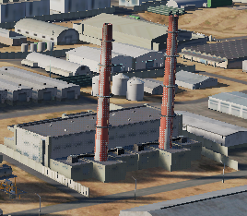
 | 500 IBS | 1000 IBS | 2000 IBS
1x Bomb | X | X | V
2x Bombs | X | V | V
4x Bombs | V | V | V

Slide 4

 | 500 IBS | 1000 IBS | 2000 IBS
1x Bomb | X | X | V
2x Bombs | X | X | V
4x Bombs | V | V | V

Slide 5

 | 500 IBS | 1000 IBS | 2000 IBS
1x Bomb | V | V | V
2x Bombs | V | V | V
4x Bombs | V | V | V

Slide 6
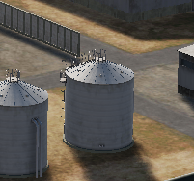
 | 500 IBS | 1000 IBS | 2000 IBS
1x Bomb | X | X | X
2x Bombs | X | X | V
4x Bombs | V | V | V

Slide 7
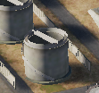
 | 500 IBS | 1000 IBS | 2000 IBS
1x Bomb | X | X | V
2x Bombs | V | V | V
4x Bombs | V | V | V

Slide 8
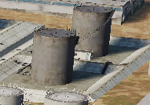
 | 500 IBS | 1000 IBS | 2000 IBS
1x Bomb | X | X | V
2x Bombs | V | V | V
4x Bombs | V | V | V

Slide 9
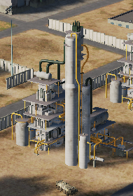
 | 500 IBS | 1000 IBS | 2000 IBS
1x Bomb | X | X | V
2x Bombs | V | V | V
4x Bombs | V | V | V

Slide 10
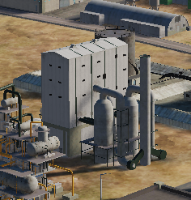
 | 500 IBS | 1000 IBS | 2000 IBS
1x Bomb | X | X | V
2x Bombs | X | V | V
4x Bombs | V | V | V

Slide 11
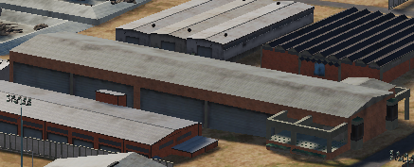
 | 500 IBS | 1000 IBS | 2000 IBS
1x Bomb | X | V | V
2x Bombs | X | V | V
4x Bombs | V | V | V

Slide 12
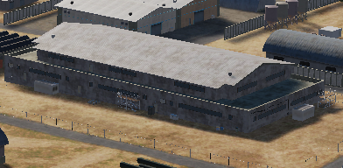
 | 500 IBS | 1000 IBS | 2000 IBS
1x Bomb | X | V | V
2x Bombs | V | V | V
4x Bombs | V | V | V

Slide 13
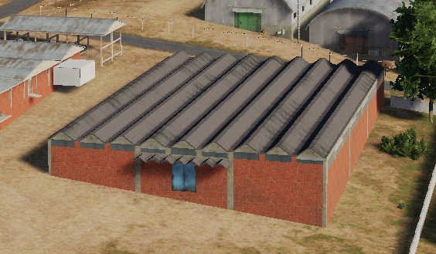
 | 500 IBS | 1000 IBS | 2000 IBS
1x Bomb | X | X | V
2x Bombs | X | V | V
4x Bombs | V | V | V

Slide 14
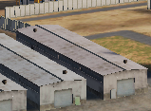
 | 500 IBS | 1000 IBS | 2000 IBS
1x Bomb | X | X | V
2x Bombs | X | V | V
4x Bombs | V | V | V

Slide 15
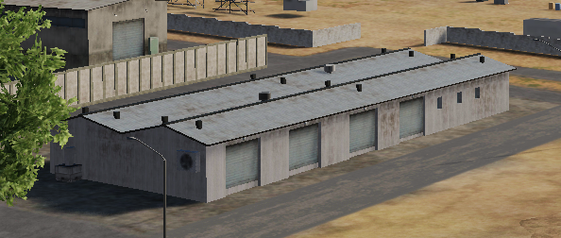
 | 500 IBS | 1000 IBS | 2000 IBS
1x Bomb | X | X | V
2x Bombs | X | V | V
4x Bombs | V | V | V

Slide 16
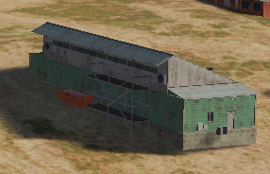
 | 500 IBS | 1000 IBS | 2000 IBS
1x Bomb | X | X | V
2x Bombs | X | V | V
4x Bombs | V | V | V

Slide 17
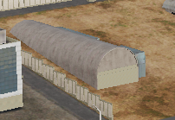
 | 500 IBS | 1000 IBS | 2000 IBS
1x Bomb | X | X | V
2x Bombs | X | V | V
4x Bombs | V | V | V

Slide 18
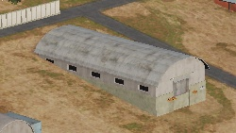
 | 500 IBS | 1000 IBS | 2000 IBS
1x Bomb | X | X | V
2x Bombs | X | V | V
4x Bombs | V | V | V

Slide 19
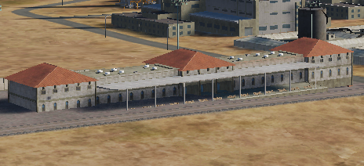
 | 500 IBS | 1000 IBS | 2000 IBS
1x Bomb | X | X | X
2x Bombs | X | X | X
4x Bombs
INDESTRUCTABLE – DO NOT USE

Slide 20
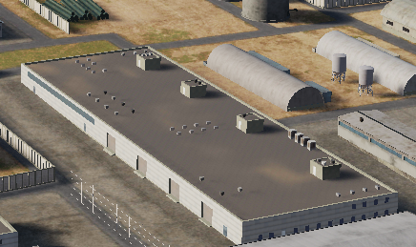
 | 500 IBS | 1000 IBS | 2000 IBS
1x Bomb | X | X | X
2x Bombs | X | X | X
4x Bombs | X | X | X
INDESTRUCTABLE – DO NOT USE

Slide 21
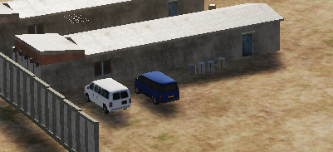
 | 500 IBS | 1000 IBS | 2000 IBS
1x Bomb | X | V | V
2x Bombs | X | V | V
4x Bombs | X | V | V

Slide 22
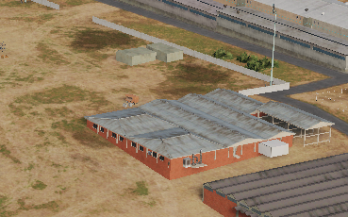
 | 500 IBS | 1000 IBS | 2000 IBS
1x Bomb | X | X | V
2x Bombs | X | V | V
4x Bombs | V | V | V

Slide 23
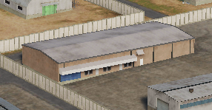
 | 500 IBS | 1000 IBS | 2000 IBS
1x Bomb | X | V | V
2x Bombs | X | V | V
4x Bombs | V | V | V

Slide 24
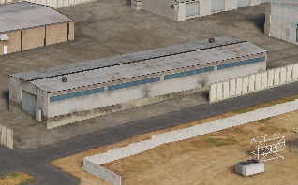
 | 500 IBS | 1000 IBS | 2000 IBS
1x Bomb | V | V | V
2x Bombs | V | V | V
4x Bombs | V | V | V

Slide 25
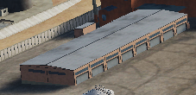
 | 500 IBS | 1000 IBS | 2000 IBS
1x Bomb | X | X | V
2x Bombs | X | V | V
4x Bombs | V | V | V

Slide 26
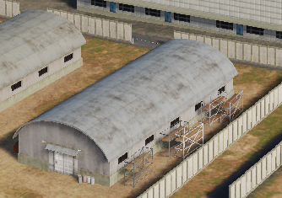
 | 500 IBS | 1000 IBS | 2000 IBS
1x Bomb | X | X | V
2x Bombs | X | V | V
4x Bombs | V | V | V

Slide 27
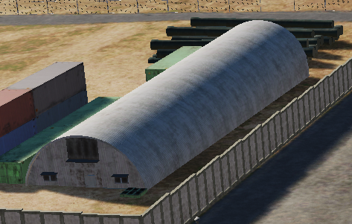
 | 500 IBS | 1000 IBS | 2000 IBS
1x Bomb | X | X | V
2x Bombs | X | V | V
4x Bombs | V | V | V

Slide 28
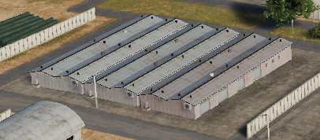
 | 500 IBS | 1000 IBS | 2000 IBS
1x Bomb | X | X | V
2x Bombs | V | V | V
4x Bombs | V | V | V

Slide 29
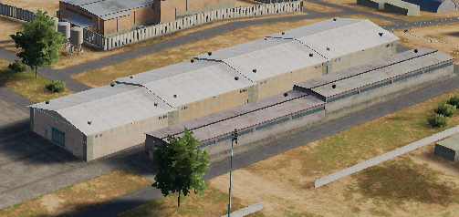
 | 500 IBS | 1000 IBS | 2000 IBS
1x Bomb | X | X | V
2x Bombs | V | V | V
4x Bombs | V | V | V

Slide 30
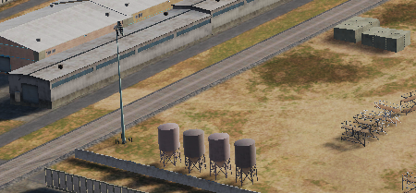
 | 500 IBS | 1000 IBS | 2000 IBS
1x Bomb | X | X | V
2x Bombs | X | V | V
4x Bombs | V | V | V

Slide 31
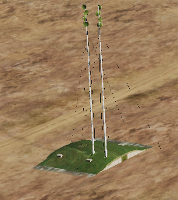
 | 500 IBS | 1000 IBS | 2000 IBS
1x Bomb | X | X | X
2x Bombs | X | X | V (Penetrator only)
4x Bombs | X | X | V

Slide 32
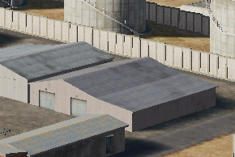
 | 500 IBS | 1000 IBS | 2000 IBS
1x Bomb | X | X | V
2x Bombs | X | V | V
4x Bombs | V | V | V

